Slide 1

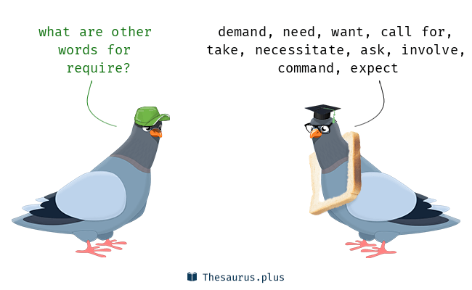
Software Engineering
WEEK 6
ENGR. Muhammad UMER HAROON

Slide 2

WEEK 6
Requirements

Slide 3


Slide 4
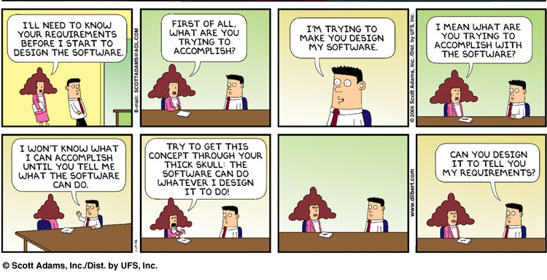

Slide 5
What is a requirement?
It may range from a high-level abstract statement of a service or of a system constraint to a detailed mathematical functional specification.
This is inevitable as requirements may serve a dual function
May be the basis for a bid for a contract - therefore must be open to interpretation;
May be the basis for the contract itself - therefore must be defined in detail;
Both these statements may be called requirements.

Slide 6
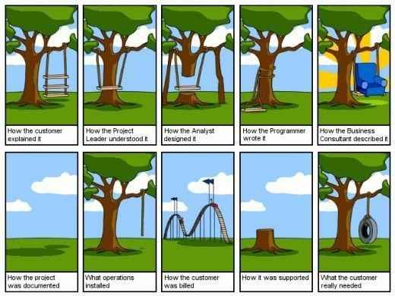

Slide 7
Requirements engineering
According to the IEEE (Institute of Electrical and Electronics Engineers) Standard 29148-2018, requirements engineering is defined as:
"The process of eliciting, analyzing, specifying, validating, and managing the needs and constraints of stakeholders for a system or software product throughout the product life cycle."

Slide 8
Requirements abstraction
“If a company wishes to let a contract for a large software development project, it must define its needs in a sufficiently abstract way that a solution is not pre-defined.
The requirements must be written so that several contractors can bid for the contract, offering, perhaps, different ways of meeting the client organization’s needs.
Notes:
Requirements abstraction, as defined by Alan M. Davis in his book "Software Requirements: Objects, Functions, and States", is the process of identifying the most important and essential aspects of a system's requirements, and simplifying them into a more manageable set of functional requirements.

Slide 9

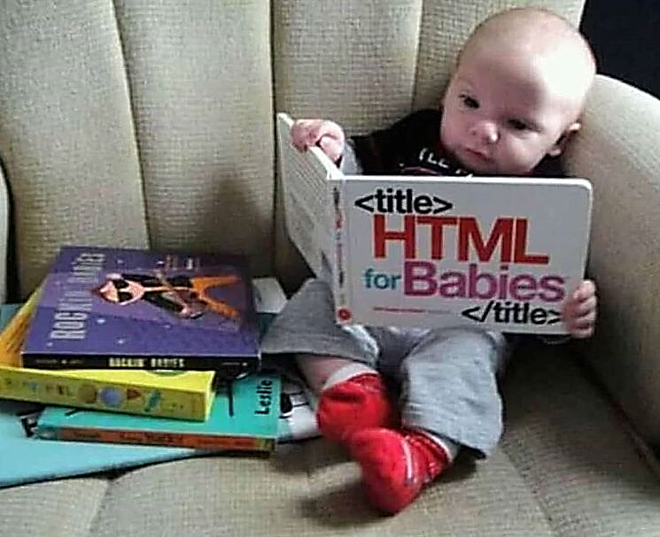
Types of requirement
User requirements
Statements in natural language plus diagrams of the services the system provides and its operational constraints. Written for customers.
System requirements
A structured document setting out detailed descriptions of the system’s functions, services and operational constraints. Defines what should be implemented so may be part of a contract between client and contractor.

Slide 10
User and system requirements

Slide 11
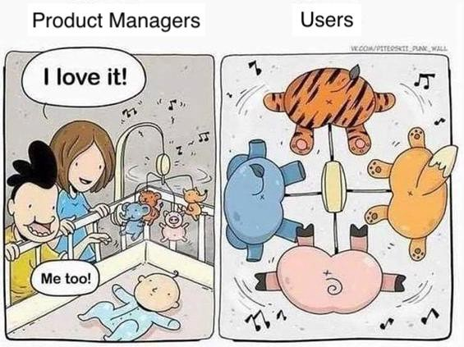
What is the role of Stakeholders in Requirements ?

Slide 12
How requirement engineering varies with plan driven approach and agile approaches
One of the key differences between plan-driven and agile approaches to requirements engineering is the level of documentation and planning involved.
Plan-driven approaches tend to rely on detailed documentation and planning up front, whereas agile approaches emphasize flexibility and adaptability and may require less documentation.
In addition, plan-driven approaches tend to assume that requirements are stable and well-understood, whereas agile approaches assume that requirements may change over time and require ongoing collaboration and feedback from stakeholders.

Slide 13
Functional and non-functional requirements
Functional requirements
Statements of services the system should provide, how the system should react to particular inputs and how the system should behave in particular situations.
May state what the system should not do.
Non-functional requirements
Constraints on the services or functions offered by the system such as timing constraints, constraints on the development process, standards, etc.
Often apply to the system as a whole rather than individual features or services.
Domain requirements
Constraints on the system from the domain of operation

Slide 14
Functional requirements define what a product must do, what its features and functions are.
Nonfunctional requirements describe the general properties of a system. They are also known as quality attributes.

Slide 15
Functional requirements
Describe functionality or system services.
Depend on the type of software, expected users and the type of system where the software is used.
Functional user requirements may be high-level statements of what the system should do.
Functional system requirements should describe the system services in detail.

Slide 16
Mentcare system: functional requirements
A user shall be able to search the appointments lists for all clinics.
The system shall generate each day, for each clinic, a list of patients who are expected to attend appointments that day.
Each staff member using the system shall be uniquely identified by his or her 8-digit employee number.

Slide 17
Requirements imprecision
Problems arise when functional requirements are not precisely stated.
Ambiguous requirements may be interpreted in different ways by developers and users.
Consider the term ‘search’ in requirement 1
User intention – search for a patient name across all appointments in all clinics;
Developer interpretation – search for a patient name in an individual clinic. User chooses clinic then search.

Slide 18
Requirements completeness and consistency
In principle, requirements should be both complete and consistent.
Complete
They should include descriptions of all facilities required.
Consistent
There should be no conflicts or contradictions in the descriptions of the system facilities.
In practice, because of system and environmental complexity, it is impossible to produce a complete and consistent requirements document.

Slide 19
Non-functional requirements
These define system properties and constraints e.g. reliability, response time and storage requirements. Constraints are I/O device capability, system representations, etc.
Process requirements may also be specified mandating a particular IDE, programming language or development method.
Non-functional requirements may be more critical than functional requirements. If these are not met, the system may be useless.

Slide 20
Types of nonfunctional requirement

Slide 21
Non-functional requirements implementation
Non-functional requirements may affect the overall architecture of a system rather than the individual components.
For example, to ensure that performance requirements are met, you may have to organize the system to minimize communications between components.
A single non-functional requirement, such as a security requirement, may generate a number of related functional requirements that define system services that are required.
It may also generate requirements that restrict existing requirements.

Slide 22
Non-functional classifications
Product requirements
Requirements which specify that the delivered product must behave in a particular way e.g. execution speed, reliability, etc.
Organisational requirements
Requirements which are a consequence of organisational policies and procedures e.g. process standards used, implementation requirements, etc.
External requirements
Requirements which arise from factors which are external to the system and its development process e.g. interoperability requirements, legislative requirements, etc.

Slide 23
Examples of nonfunctional requirements in the Mentcare system
Product requirement The Mentcare system shall be available to all clinics during normal working hours (Mon–Fri, 0830–17.30). Downtime within normal working hours shall not exceed five seconds in any one day. Organizational requirement Users of the Mentcare system shall authenticate themselves using their health authority identity card. External requirement The system shall implement patient privacy provisions as set out in HStan-03-2006-priv.

Slide 24
Metrics for specifying nonfunctional requirements
Property | Measure
Speed | Processed transactions/second User/event response time Screen refresh time
Size | Mbytes Number of ROM chips
Ease of use | Training time Number of help frames
Reliability | Mean time to failure Probability of unavailability Rate of failure occurrence Availability
Robustness | Time to restart after failure Percentage of events causing failure Probability of data corruption on failure
Portability | Percentage of target dependent statements Number of target systems

Slide 25
Requirements engineering processes

Slide 26
Requirements engineering processes
The processes used for RE vary widely depending on the application domain, the people involved and the organisation developing the requirements.
However, there are a number of generic activities common to all processes
Requirements elicitation;
Requirements analysis;
Requirements validation;
Requirements management.
In practice, RE is an iterative activity in which these processes are interleaved.

Slide 27
A spiral view of the requirements engineering process

Slide 28
Requirements elicitation

Slide 29
Requirements elicitation
Software engineers work with a range of system stakeholders to find out about the application domain, the services that the system should provide, the required system performance, hardware constraints, other systems, etc.

Slide 30
Methods of elicitation
Interviews
Ethnography
Stories
scenarios

Slide 31
Requirements specification

Slide 32
Requirements specification
The process of writing down the user and system requirements in a requirements document.
The requirements may be part of a contract for the system development
It is therefore important that these are as complete as possible.

Slide 33
Ways of writing a system requirements specification
Notation | Description
Natural language | The requirements are written using numbered sentences in natural language. Each sentence should express one requirement.
Structured natural language | The requirements are written in natural language on a standard form or template. Each field provides information about an aspect of the requirement.
Design description languages | This approach uses a language like a programming language, but with more abstract features to specify the requirements by defining an operational model of the system. This approach is now rarely used although it can be useful for interface specifications.
Graphical notations | Graphical models, supplemented by text annotations, are used to define the functional requirements for the system; UML use case and sequence diagrams are commonly used.
Mathematical specifications | These notations are based on mathematical concepts such as finite-state machines or sets. Although these unambiguous specifications can reduce the ambiguity in a requirements document, most customers don’t understand a formal specification. They cannot check that it represents what they want and are reluctant to accept it as a system contract

Slide 34
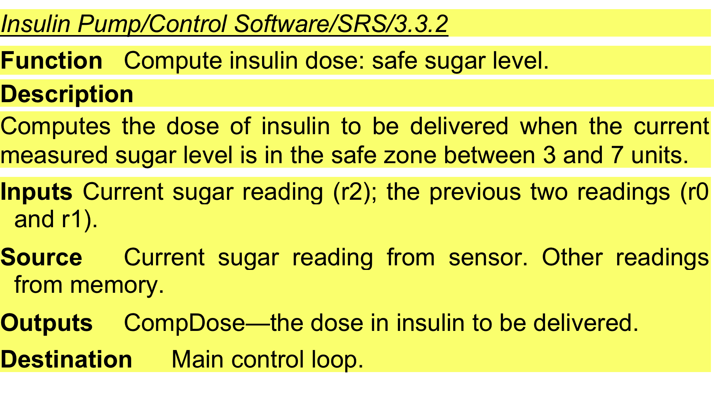
example

Slide 35
Use cases
Use-cases are a kind of scenario that are included in the UML.
Use cases identify the actors in an interaction and which describe the interaction itself.
A set of use cases should describe all possible interactions with the system.
High-level graphical model supplemented by more detailed tabular description (see Chapter 5).
UML sequence diagrams may be used to add detail to use-cases by showing the sequence of event processing in the system.

Slide 36
Use cases for the Mentcare system

Slide 37
The software requirements document
The software requirements document is the official statement of what is required of the system developers.
Should include both a definition of user requirements and a specification of the system requirements.
It is NOT a design document. As far as possible, it should set of WHAT the system should do rather than HOW it should do it.

Slide 38
Requirements validation

Slide 39
Validity. Does the system provide the functions which best support the customer’s needs?
Consistency. Are there any requirements conflicts?
Completeness. Are all functions required by the customer included?
Realism. Can the requirements be implemented given available budget and technology
Verifiability. Can the requirements be checked?

Slide 40
Requirements management

Slide 41
Requirements management is the process of managing changing requirements during the requirements engineering process and system development.
New requirements emerge as a system is being developed and after it has gone into use.
You need to keep track of individual requirements and maintain links between dependent requirements so that you can assess the impact of requirements changes. You need to establish a formal process for making change proposals and linking these to system requirements.

Slide 42
Requirements management decisions
Requirements identification: Each requirement must be uniquely identified so that it can be cross-referenced with other requirements.
A change management process: This is the set of activities that assess the impact and cost of changes.
Traceability policies: These policies define the relationships between each requirement and between the requirements and the system design that should be recorded.
Tool support Tools: that may be used range from specialist requirements management systems to spreadsheets and simple database systems.

Slide 43

Sixth Week Summary
Here is what we learned

Slide 44

Thank You!

